Slide 1


SAVEETHA SCHOOL OF ENGINEERING DEPARTMENT OF ECE Drainage Monitoring System Using IoT
Name : K.Sravani
Reg no : 191312120
Dept : ECE
Year : IV
Mentor:-
Name : B.Bhuvaneswari (Asst Prof)
Dept : ECE

Slide 2
OUTLINE
Objective
Block Diagram
Implementation(software and hardware)
Conclusion
Partial Output
References

Slide 3

Objective:
The main objective of this Module is to collect data from circuits and transmits the collected data to the processor.

Slide 4
BLOC BlocK Diagram
controller
cloud
Circuit
mobile

Slide 5
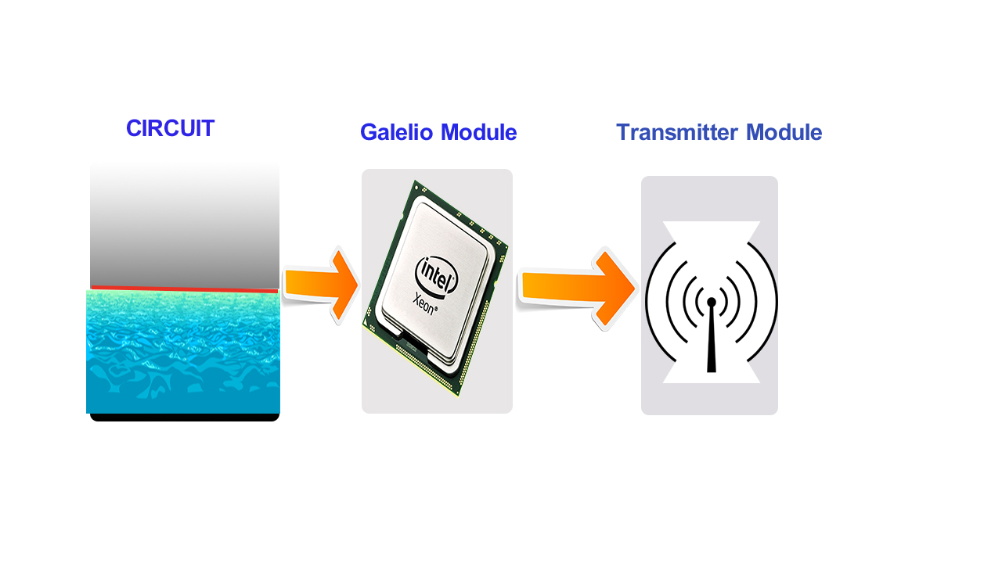
Module-1

Slide 6
IMPLEMENTATION
Circuits at different locations will collect
information of sewage flow through that node
and send it to the central system which will
generate alerts prior to complete blockage.

Slide 7
SOFTWARE USED :
Arduino
HARDWARE USED:
Galelio gen2
Wifi module
Gsm shield

Slide 8
PROGRAM
void loop()
{
// check the network connection once every 10 seconds:
lastConnectionTime = 0;
updateThingSpeakInterval = 1000;
RawValue = digitalRead(SensePin_1);
RawValue_1 = digitalRead(SensePin_2);
String analogPin0 = String(RawValue);
String analogPin_1 = String(RawValue_1);
// Print Update Response to Serial Monitor
if (client.available())
{
char c = client.read();
Serial.print(c);
}
// Disconnect from ThingSpeak
if (!client.connected() && lastConnected)
{
Serial.println("...disconnected");
Serial.println();
client.stop();
}

Slide 9
STEPS
Required changes in the system –
1. Detect the location
2. Prior information of the blockage
Design of SMART DRAINAGE SYSTEM.
System governing the flow of sewage from pipes.
To detect variations in the drainage flow.
Collection of data.
Obtain prior alerts regarding blocks and locate them using IOT

Slide 10
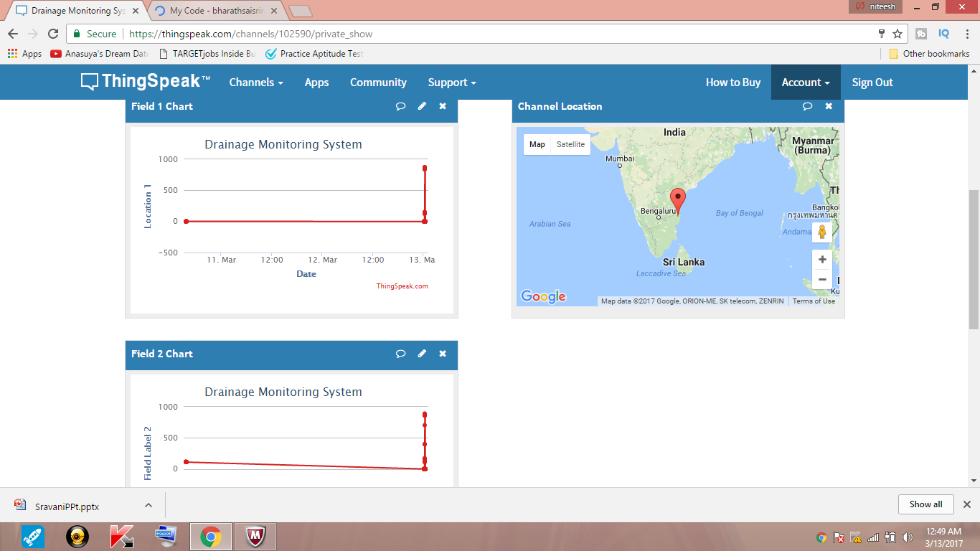
Output

Slide 11
Conclusion
Thus the clogs in the drainage gets identified using these circuit. And the concerned authorities notified from the cloud and GSM.

Slide 12
References
[1] Lazarescu, M.T., "Design of a WSN Platform for Long-Term Environmental Monitoring for IoT Applications," Emerging and Selected Topics in Circuits and Systems, IEEE Journal on , vol.3, no.1, pp.45-54, March 2013.
[2] Kelly, S.D.T.; Suryadevara, N.K.; Mukhopadhyay, S.C., "Towards the Implementation of IoT for Environmental Condition Monitoring in Homes," Sensors Journal, IEEE, vol.13, no.10, pp.3846-3853, Oct. 2013.
[3] Romer, K.; Mattern, F., "The design space of wireless sensor networks," Wireless Communications, IEEE , vol.11, no.6, pp.54,61, Dec. 2004
[4] M. Kuorilehto, M. Kohvakka, J. Suhonen, P. Hmlinen, M. Hnnikinen, and T. D. Hmlinen, Ultra-Low Energy Wireless Sensor Networks in Practice. New York: Wiley, 2007.
[5] K. Romer and F. Mattern, “The design space of wireless sensor networks,” IEEE Wireless Comm., vol. 11, no. 6, pp. 54–61, Dec. 2004.

Slide 13
THANK YOU!!!

